Slide 1
Welcome to the IFD gala evening 2025

Slide 2
Sabine und Henrik stellen sich vor
Sicherheitshinweise
Practicalities

Slide 3
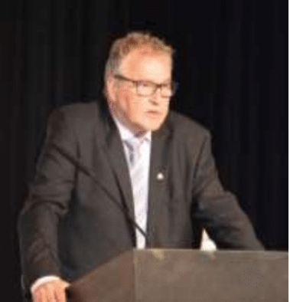
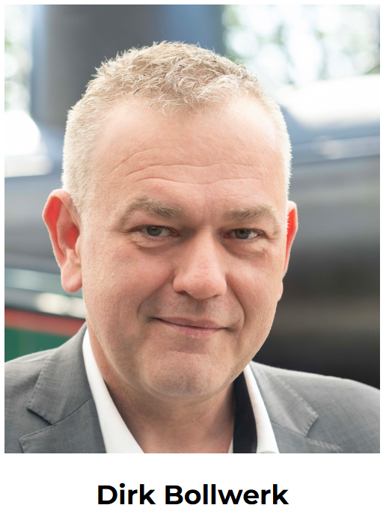
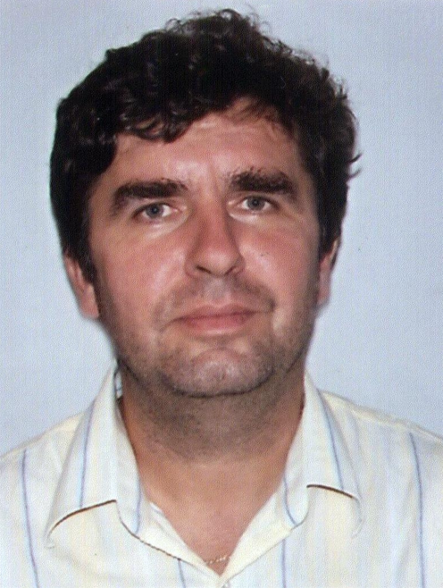
Welcome by the presidents
Walter Bisig,
former IFD President
Dirk Bollwerk,
IFD President
Eduard Jamrich
President of
Cech strechárov Slovenska

Slide 4
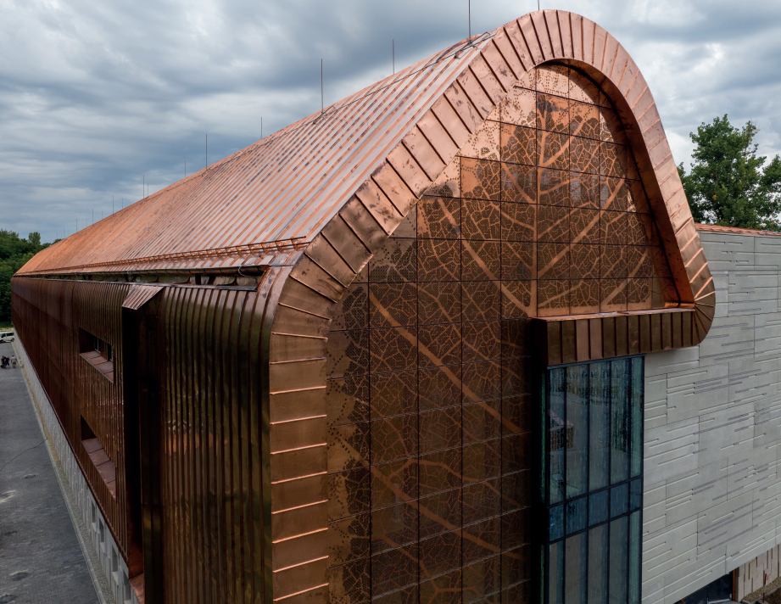
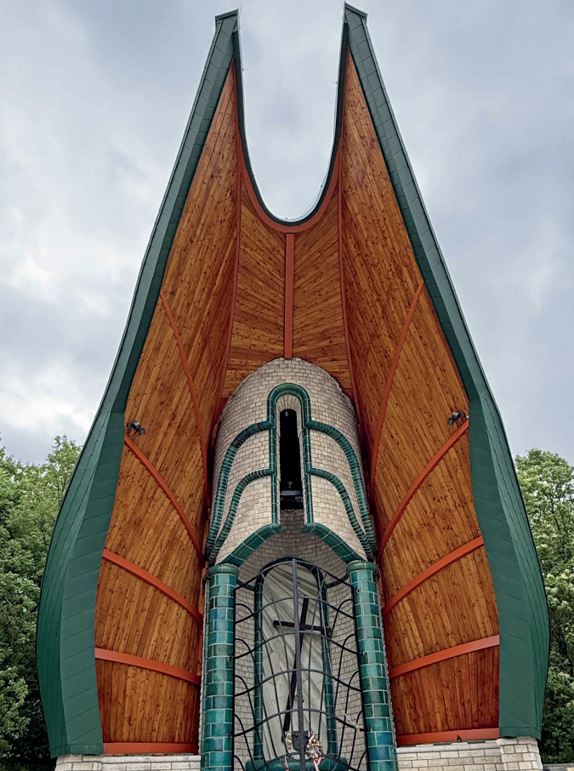
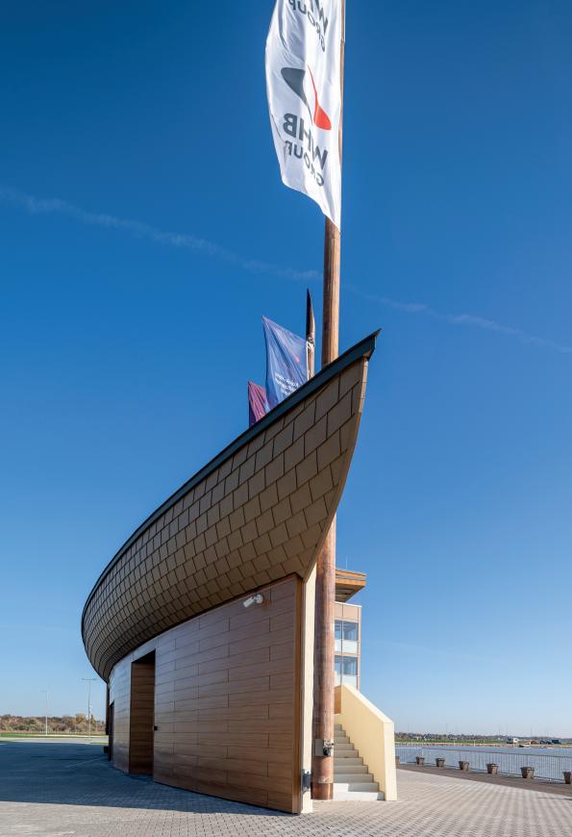
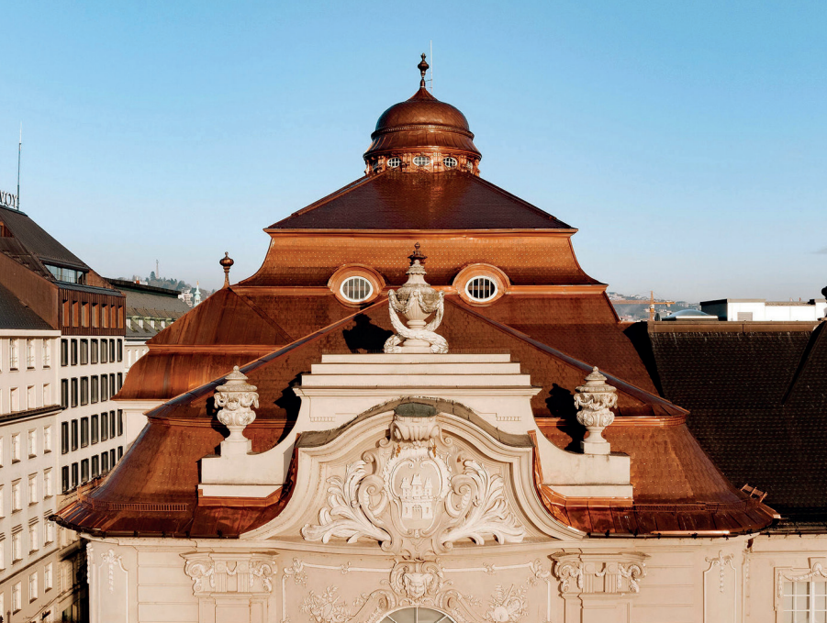
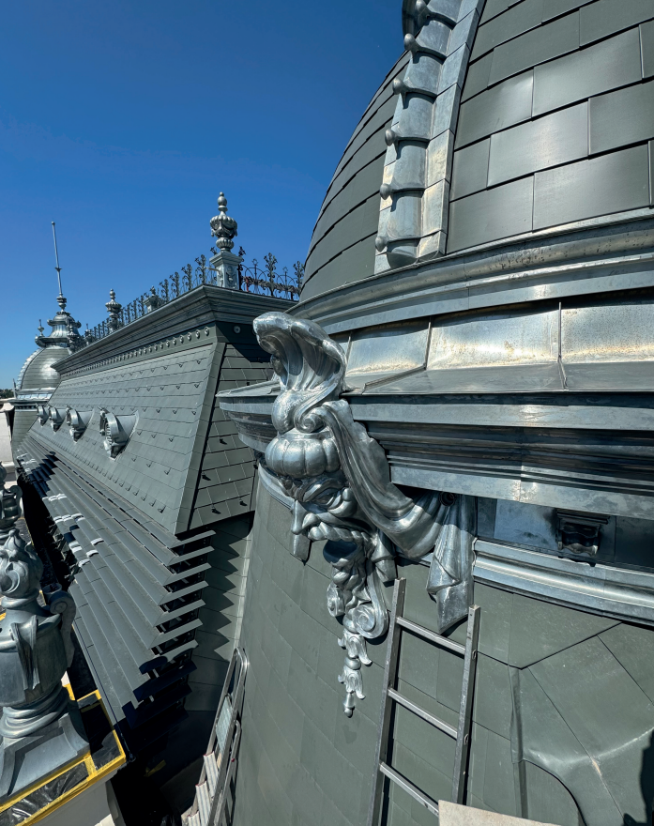
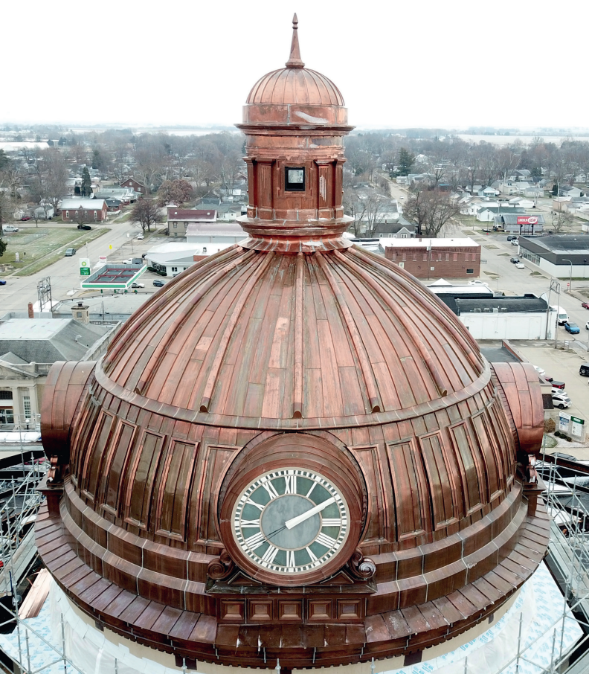
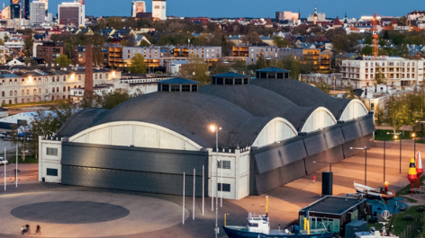
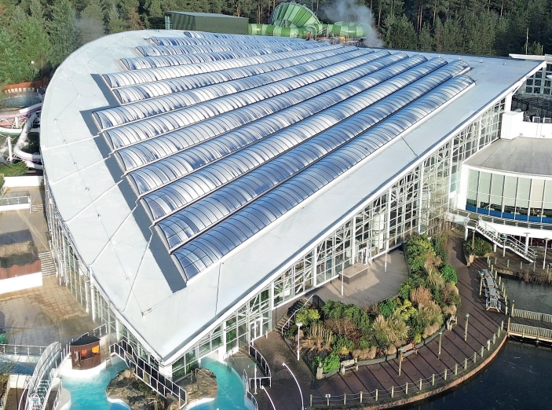
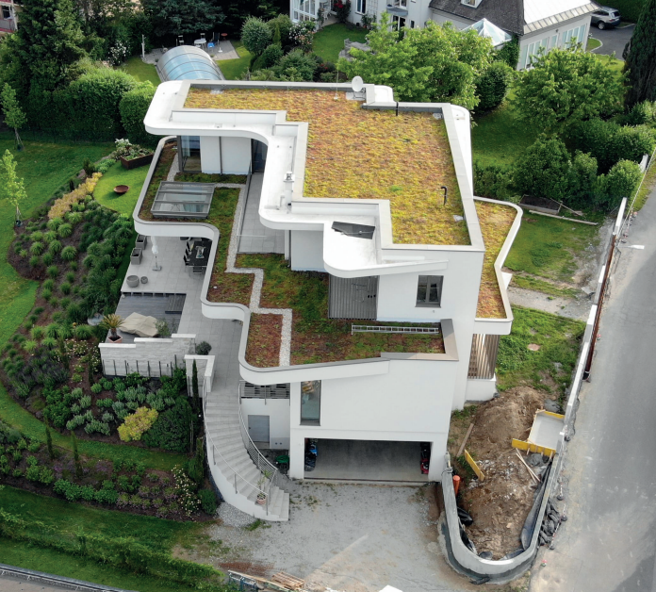
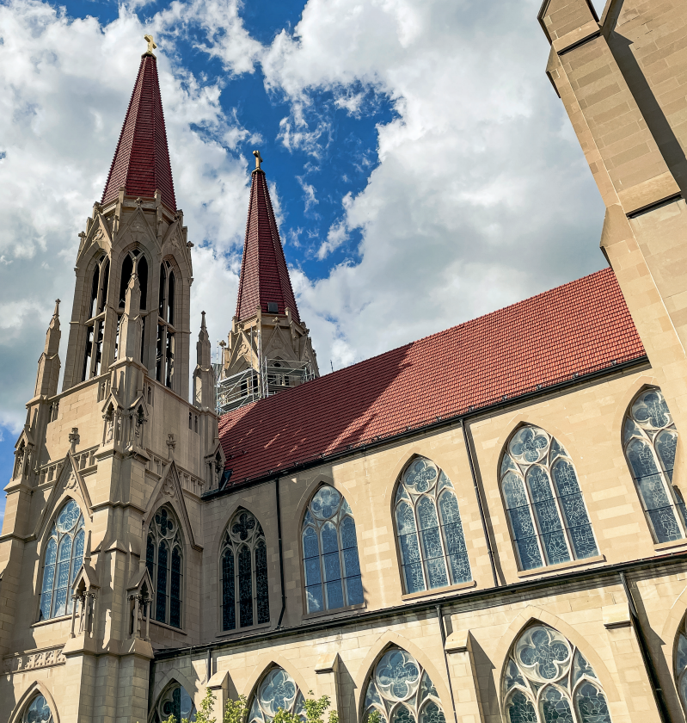
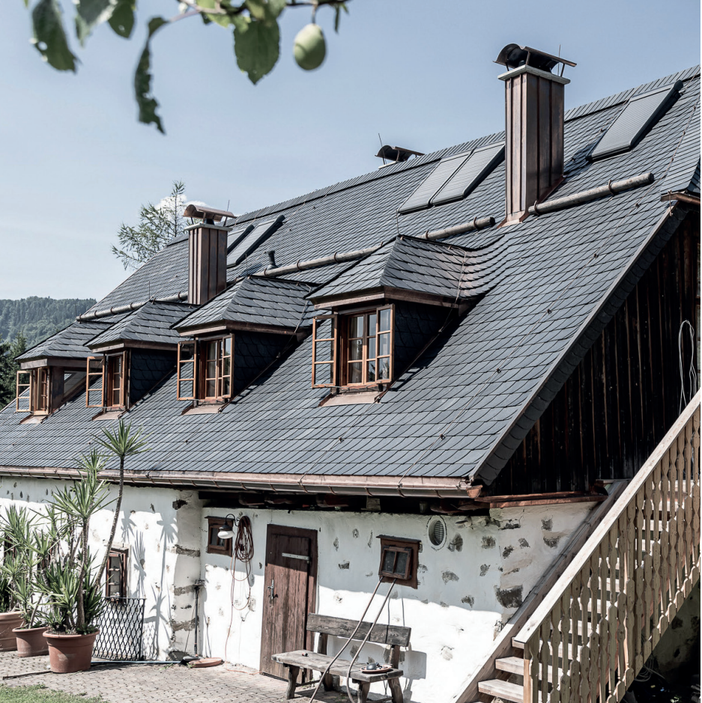
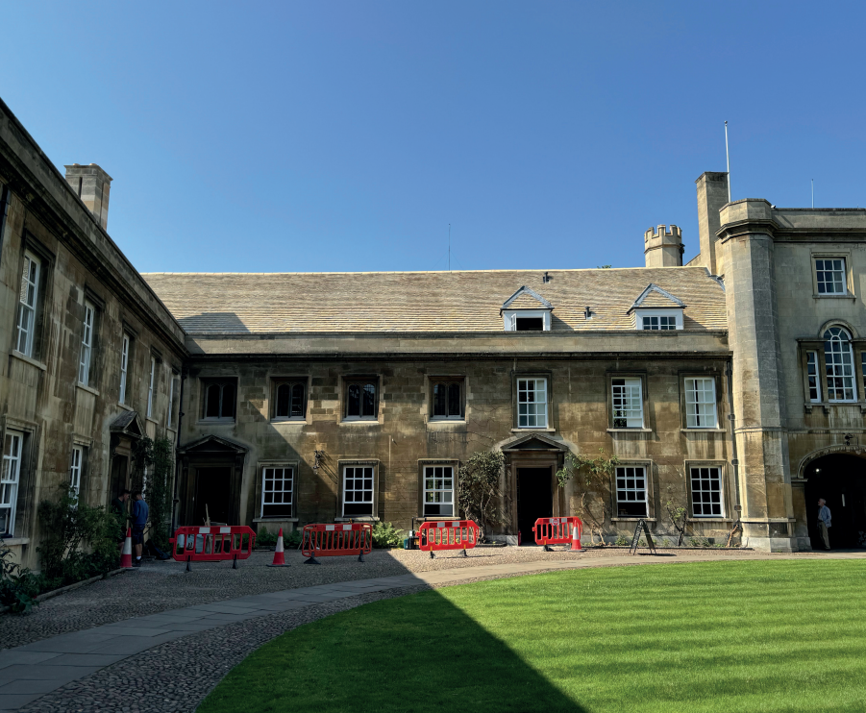
IFD Award 2025
Tonight, we are honoring 12 companies from all over the world for their true excellence and geniality within 4 categories
Façade
Metal roof
Flat roof
Pitched roof
Almost 100 projects

Slide 5
Bilder von den Einreichungen?

Slide 6
Who and how?
The jury consists of the board members and the chairs of the technical commissions
The process
Starts with a preliminary and individual evaluation of the various projects (through a point scoring)
When all point are given, a second round is compiled → top 5-8 projects
When individual jury members wants to discuss a specific project outside top 8 then this is done
Finally, the top projects are again scored by the individual jury member and the top three projects/the winners are identified
The most important evaluation criterion is the craftmen side of the various projects (documented by written description (process, technical challenge, products used etc.) as well as the pictures/videos!
Be aware the IFD Award it is not an ‘architectural’ competition, still - the overall visual look and feel of the projects play a role

Slide 7







IFD Award 2025 – Façade
We received 22 projects this year from 7 countries
Top three nominees are

Slide 8
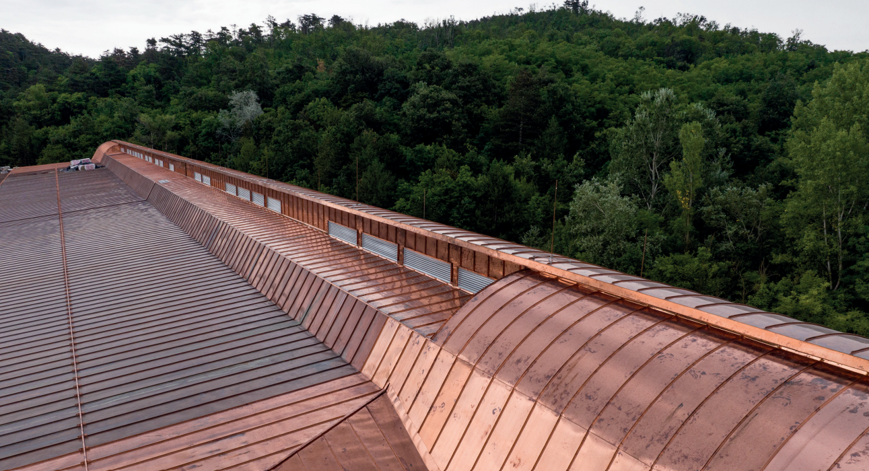
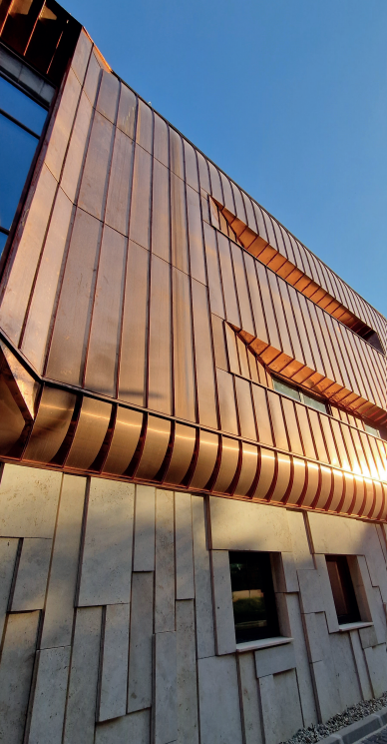
National Széchenyi Library Archival Center
Pilisi Pléh-Boy Kft
HUNGARY

Slide 9
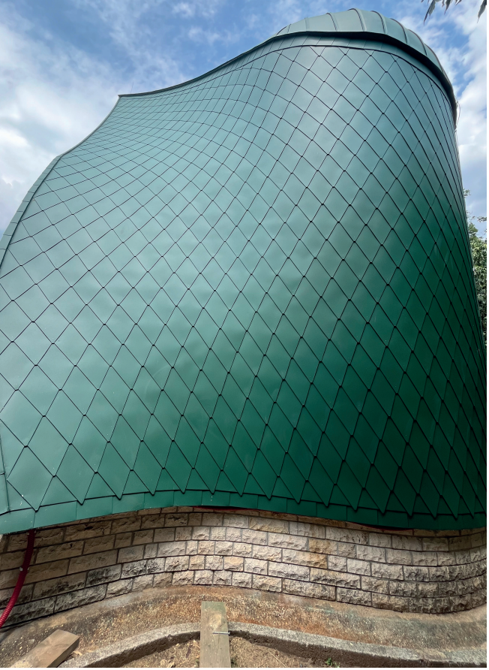
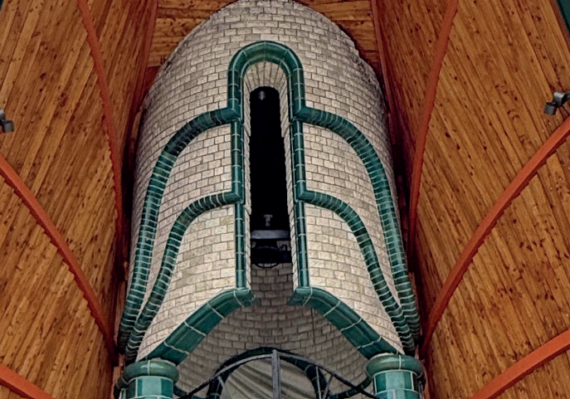
Battle of Don Memorial Site, Pákozd
Appreggio Bt,
Ervin Király and BH Metall Kft. HUNGARY

Slide 10
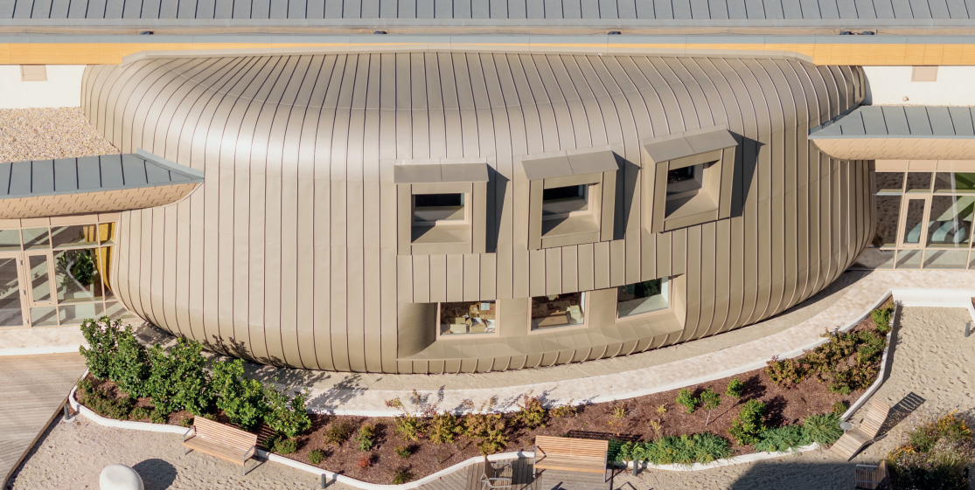
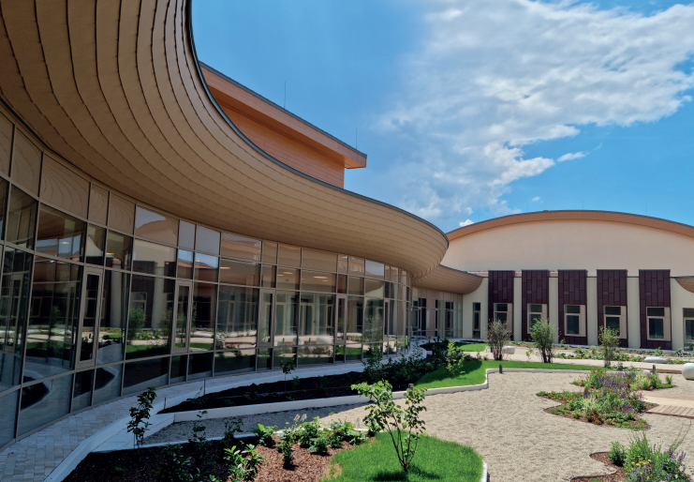
Kovács Katalin National Kayak-
Canoe Academy
Horex Kft., Bauer Bádogos és Szigetelő Kft
HUNGARY

Slide 11
And the winners are

Slide 12
3rd Place
Horex Kft., Bauer Bádogos és Szigetelő Kft
Kovács Katalin National Kayak-
Canoe Academy

Slide 13
2nd Place
Pilisi Pléh-Boy Kft
National Széchenyi Library Archival Center

Slide 14
1st Place
Appreggio Bt,
Ervin Király and BH Metall Kft.
Battle of Don Memorial Site, Pákozd

Slide 15



IFD Award 2025 – Metal roof
We received 32 projects this year from 7 countries
Top three nominees are

Slide 16
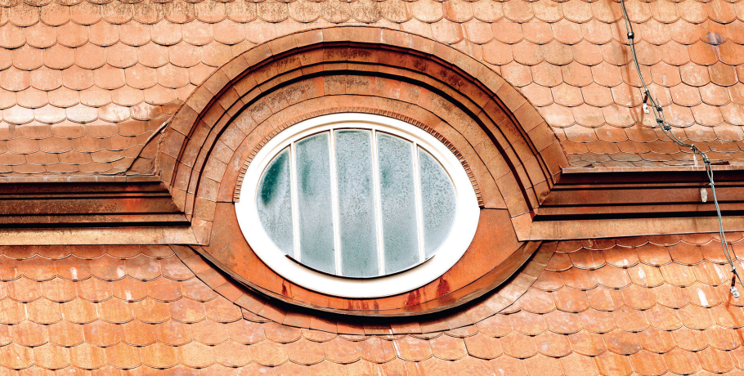
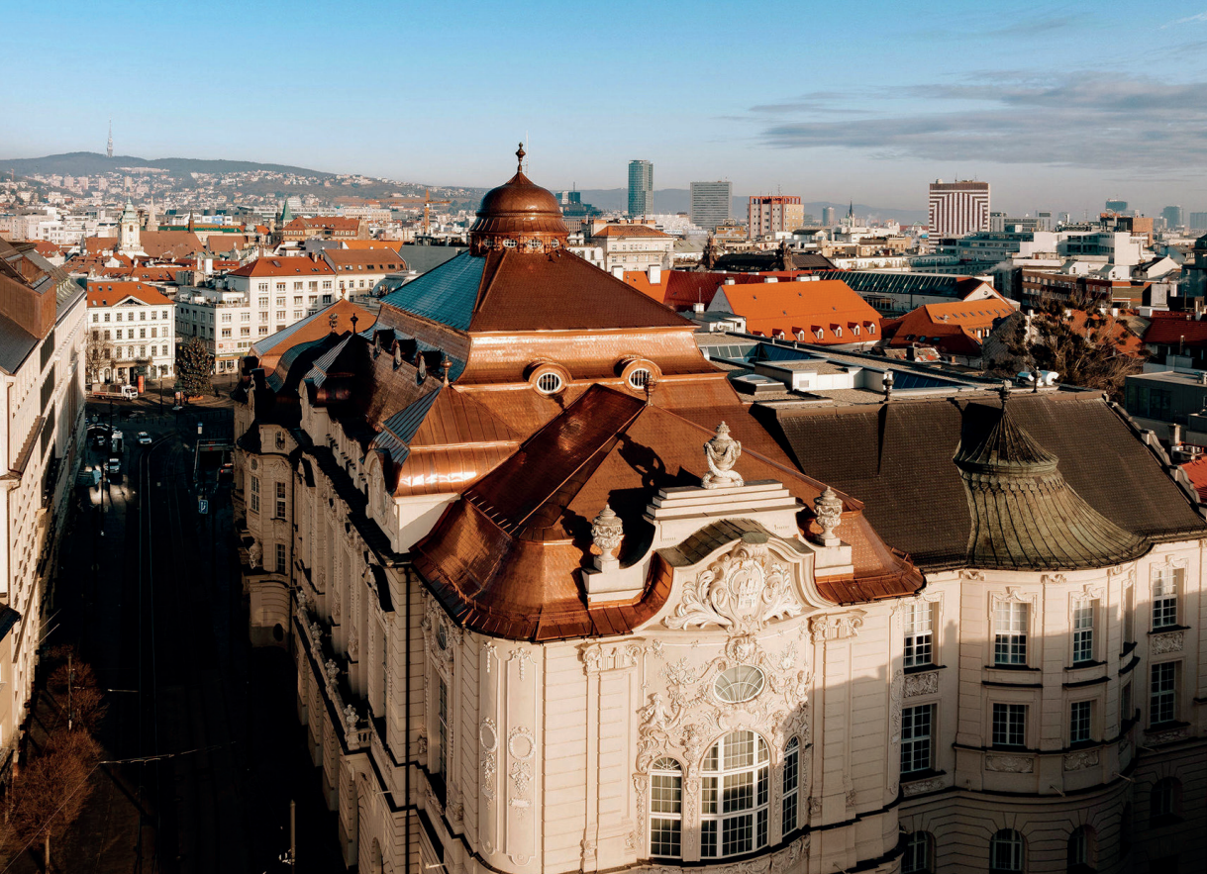
Reduta, Bratislava
SiQiS-S, s. r. o
SLOVAKIA

Slide 17
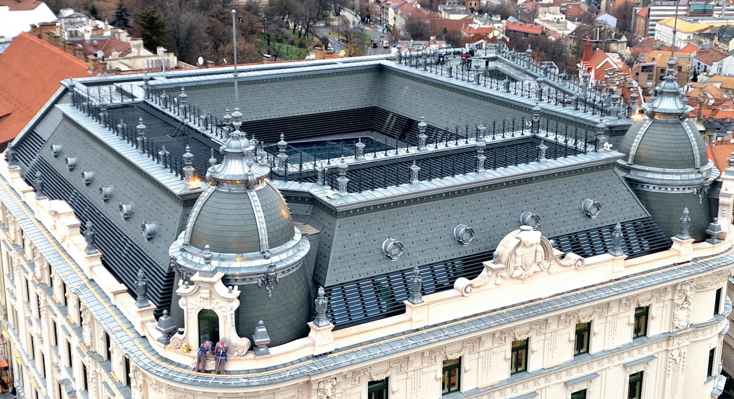
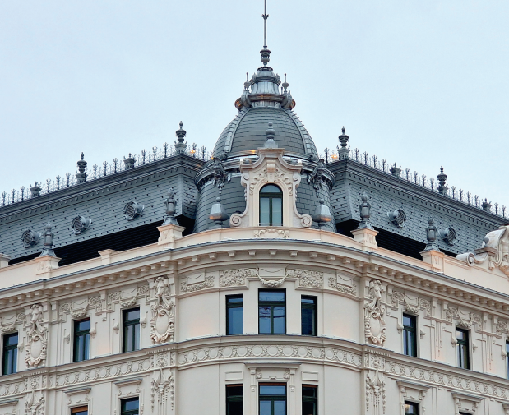
Reconstruction of the former Red Cross headquarters
Pilisi Pléh-Boy Kft
HUNGARY

Slide 18
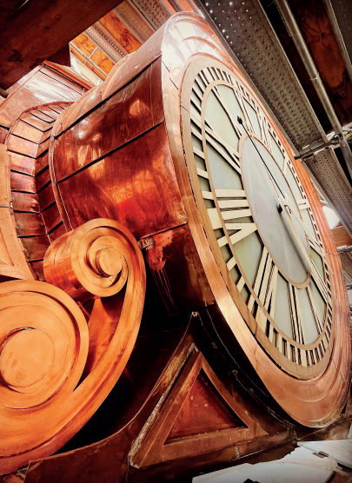
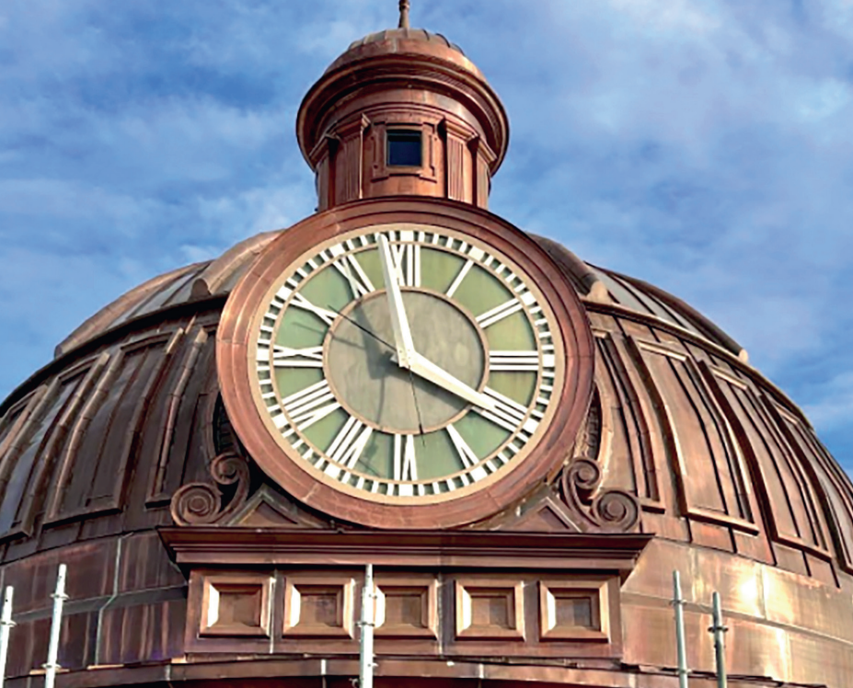
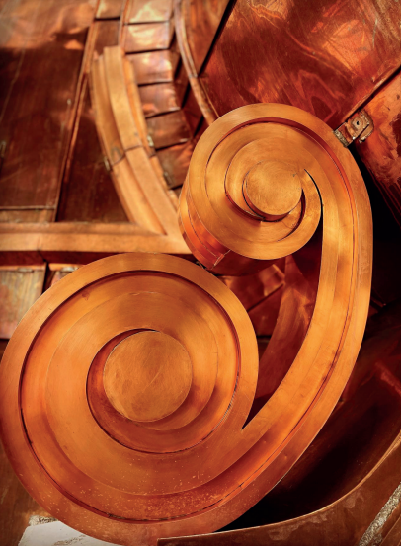
Logan County Courthouse Copper Dome Replacement
The Durable Slate Company
USA

Slide 19
And the winners are

Slide 20
3rd Place
SiQiS-S, s. r. o
Reduta, Bratislava

Slide 21
2nd Place
Pilisi Pléh-Boy Kft
Reconstruction of the former Red Cross headquarters

Slide 22
1st Place
The Durable Slate Company
Logan County Courthouse Copper Dome Replacement

Slide 23

It time for a small break – be back in 30 minutes for the next winners!!!

Slide 24

Be back in 30 minutes!!!

Slide 25

IFD Award 2025 – Flat roof
We received 19 projects this year from 7 countries
Top three nominees are

Slide 26
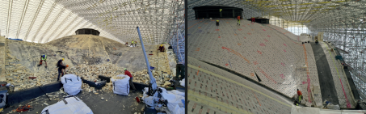
Seaplane Harbour, Estonian Maritime Museum, TALLINN
ARUNA-EHITUS OÜ

Slide 27
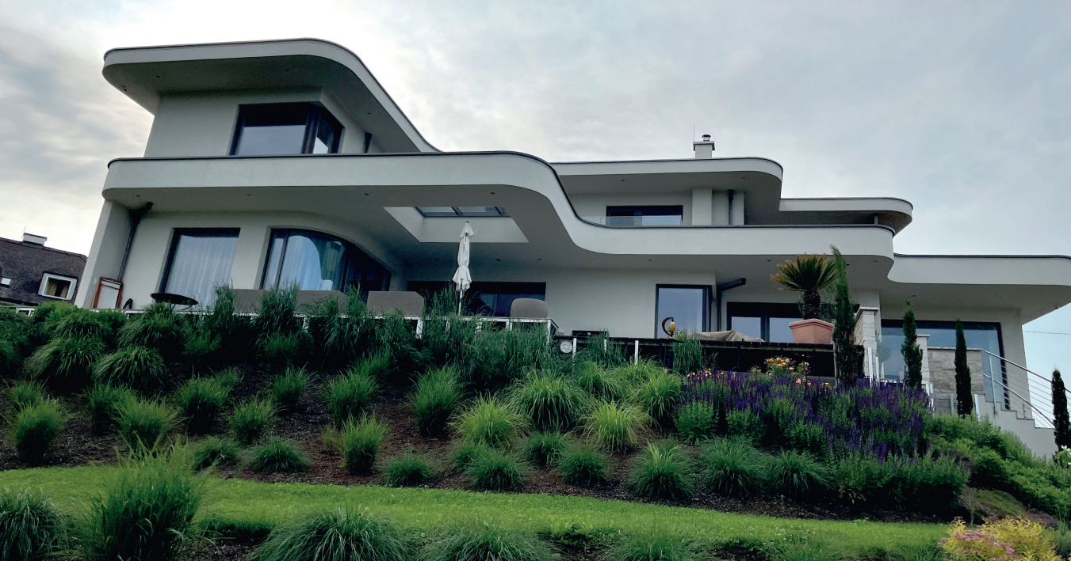
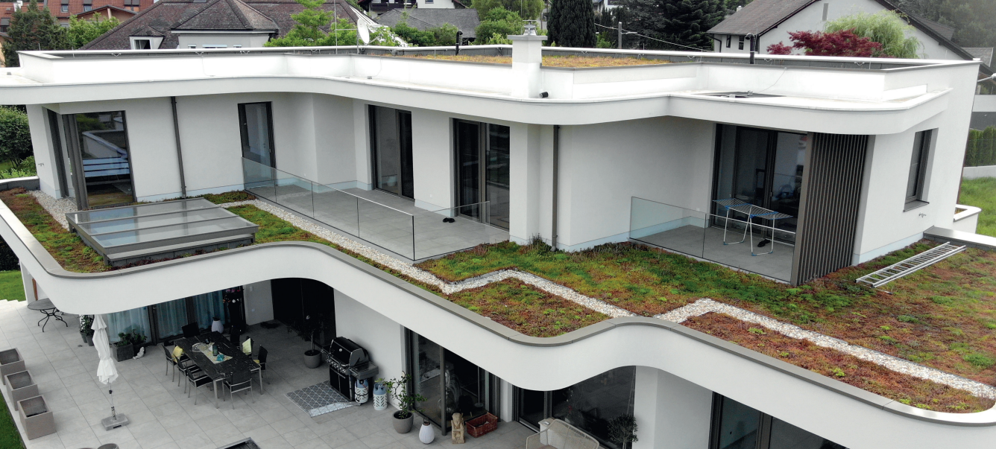
Single-family house K./ Graz-Andritz
Spitzer Gesellschaft m.b.H

Slide 28
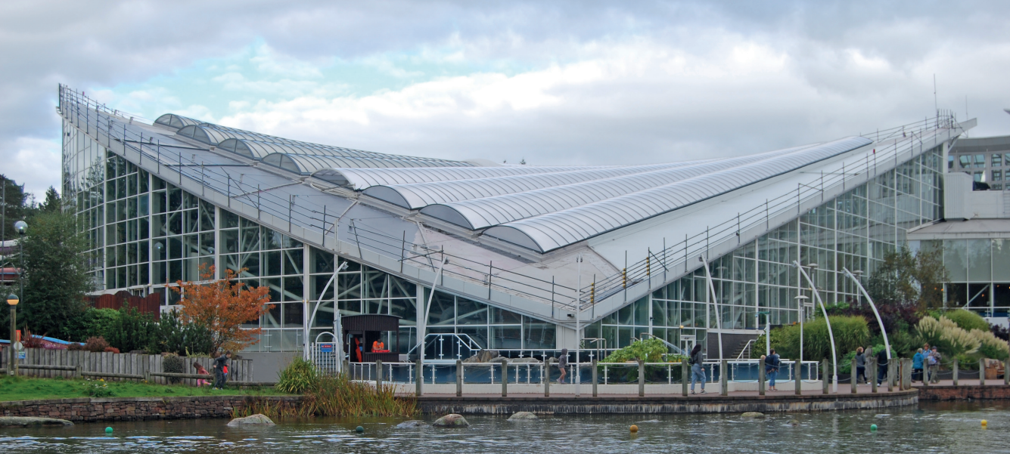
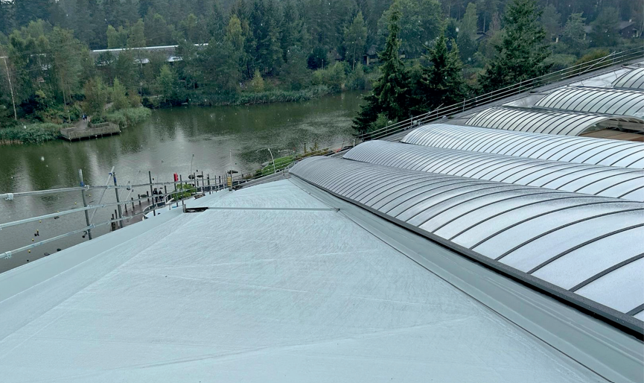
Whinfell Forest Center Parcs, Subtropical Swimming Paradise
Central Group

Slide 29
And the winners are

Slide 30
3rd Place
ARUNA-EHITUS OÜ
Seaplane Harbour, Estonian Maritime Museum, TALLINN

Slide 31
2nd Place
Central Group
Whinfell Forest Center Parcs, Subtropical Swimming Paradise

Slide 32
1st Place
Spitzer
Gesellschaft m.b.H
Single-family house K./ Graz-Andritz

Slide 33
IFD Award 2025 – Pitched roof
We received 23 projects this year from 10 countries
Top three nominees are

Slide 34
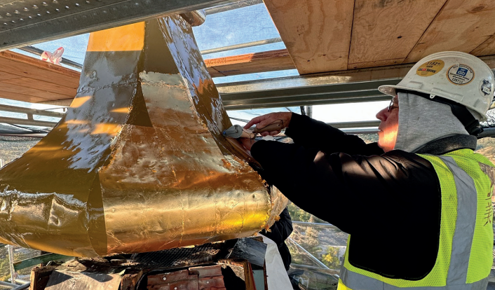
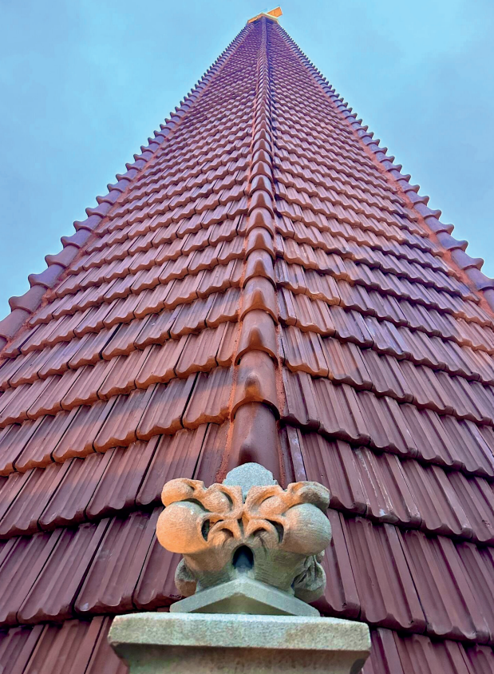
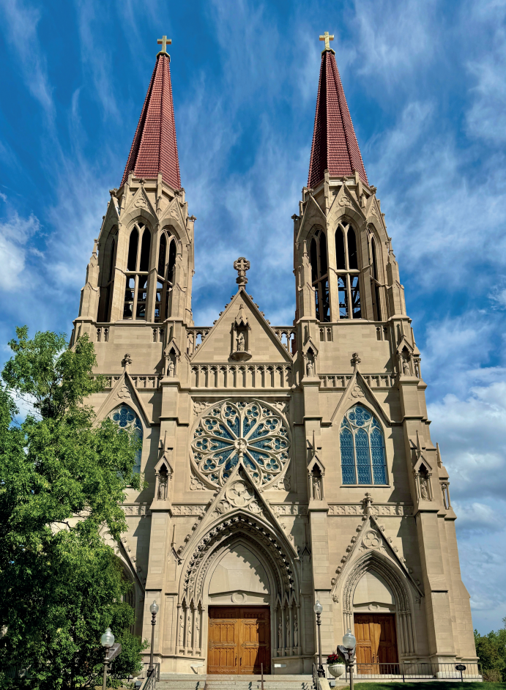
Restoration of Saint Helena Cathedral
The Durable Restoration Company

Slide 35
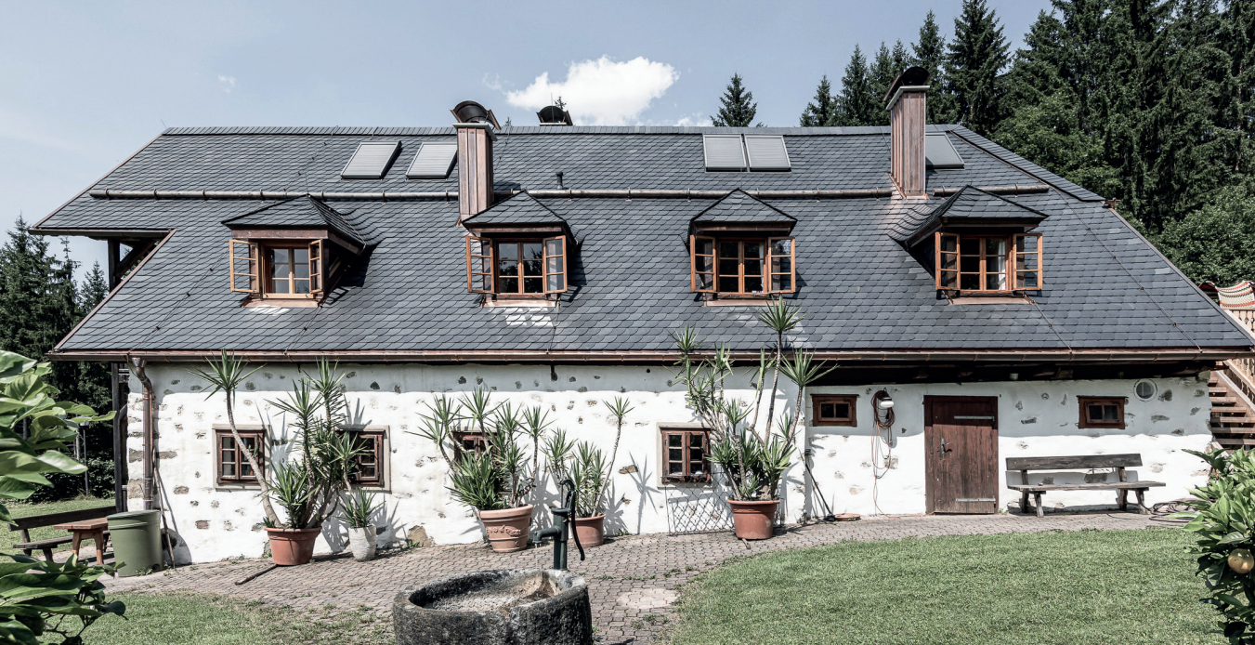
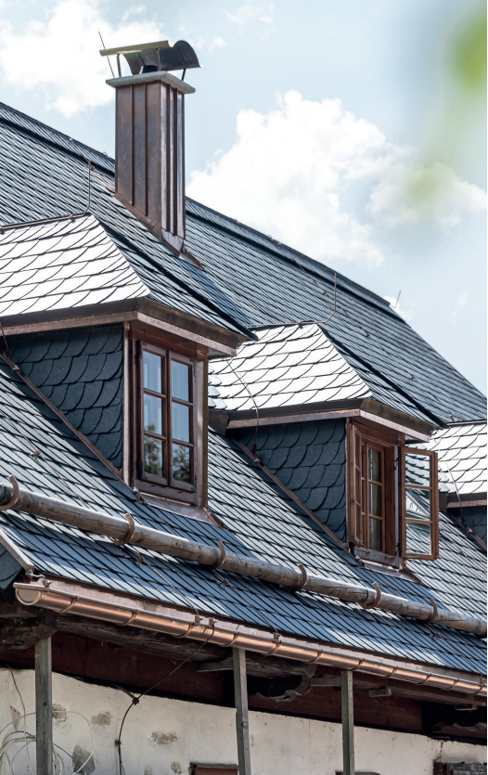
Single-family house Dentling, Altmünster
Schmid Dachbau GmbH

Slide 36
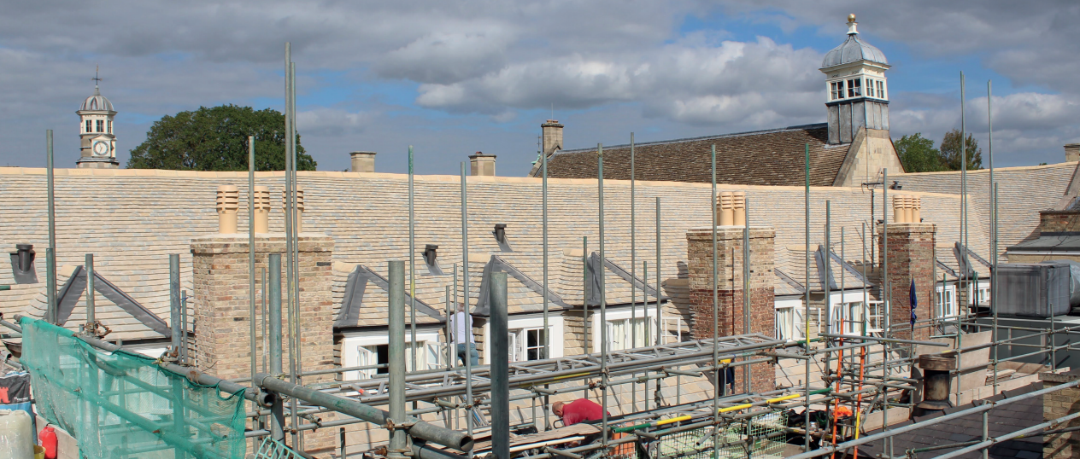
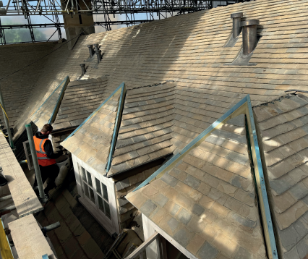
Christ’s College Cambridge
Claude N Smith Ltd

Slide 37
And the winners are

Slide 38
The Durable Restoration Company
1st Places
Schmid Dachbau
GmbH
Claude N Smith Ltd

Slide 39
Final greetings from the presidents
Walter Bisig,
former IFD President
Dirk Bollwerk,
IFD President

Slide 40
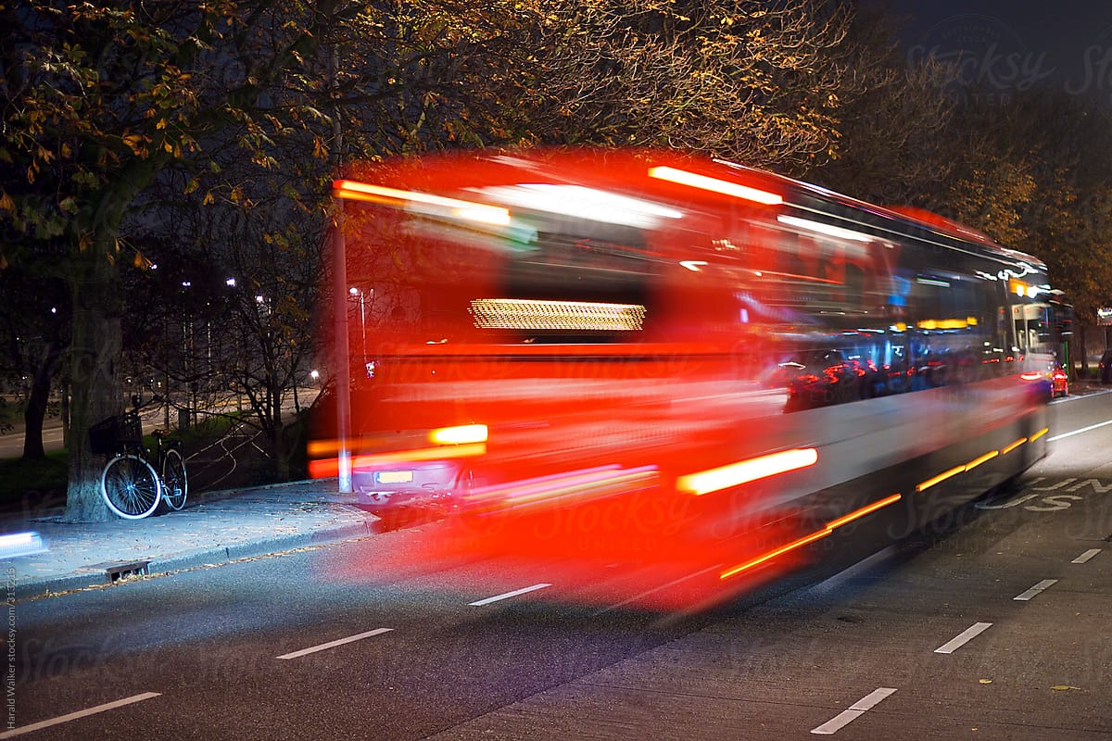
The bus for the Sheraton is leaving 24:00

Slide 41


